Slide 1

FPT Education Recruitment System
PID team - Summer 2020
Hanoi, September 10th, 2020

Slide 2
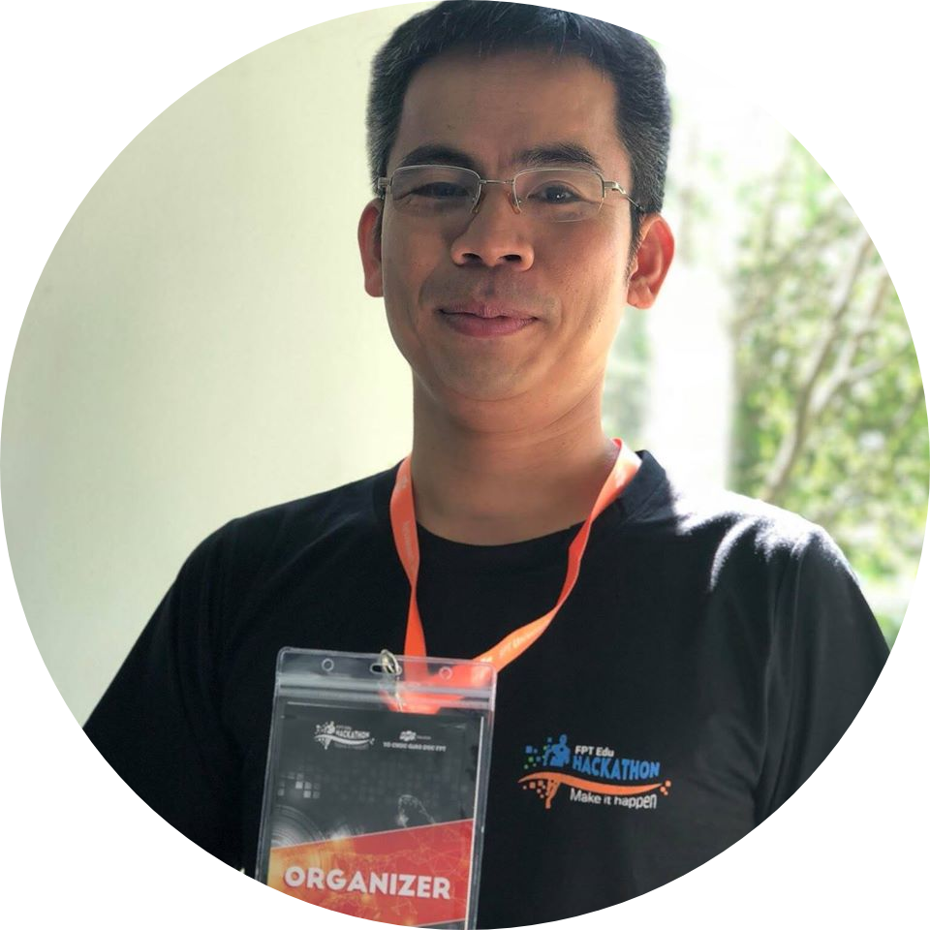





PID Team
Phan Truong Lam
Supervisor
Do Van Tuan
Team leader
Tran Quoc Dat
Team member
Bui Thanh Tung
Team member
Do Duy Luyen
Team member
Nguyen Thai Bao
Team member

Slide 3
TABLE OF CONTENT
01
04
02
05
03
06
Introduction
Software design
Project management plan
Testing
Demo - Q & A
Software requirement
specification

Slide 4
1.
Introduction
Project information
Existing systems
Project name, team members
Literature review of existing systems
Background
The proposal system
Reasons make us came up with this idea
System functions, work flows, tool and techniques

Slide 5

Project Information
Project name: FPT Education Recruitment System
Project code: FERS
Project group name: PID Team (People - Idea - Dialogue)
Product type: Web application
Timeline: From 18th May 2020 to 3st September 2020

Slide 6
Background
FPT Education: One of the four most important parts of FPT Corporation
Founded: 1999
28 training facilities in Ha Noi, Ho Chi Minh, Da Nang, Can Tho, Quy Nhon, Tay Nguyen
> 50,000 students
Training cooperation with 40 countries
176 international partners

Slide 7
Recruitment demand
2015
2016
2017
2018
2019
Background
2015
2016
2017
2018
2019

Slide 8

Background
Recruitment channels
Word of mouth
Vietnam works services

Slide 9



Background
Recruitment channels
Facebook
Linkedin
Youtube

Slide 10
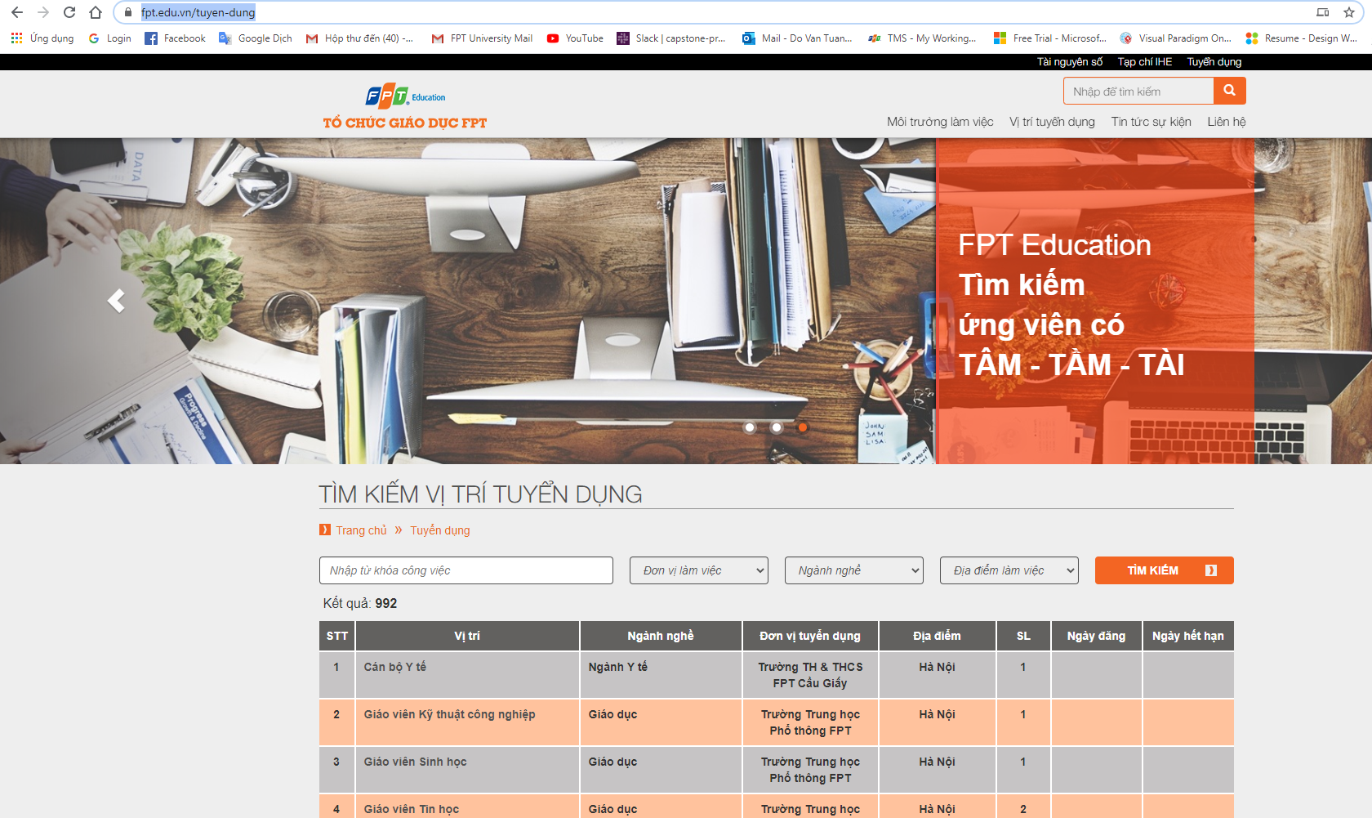
Background
Recruitment channels
Notes:
Xử lý bằng tay + file excel

Slide 11
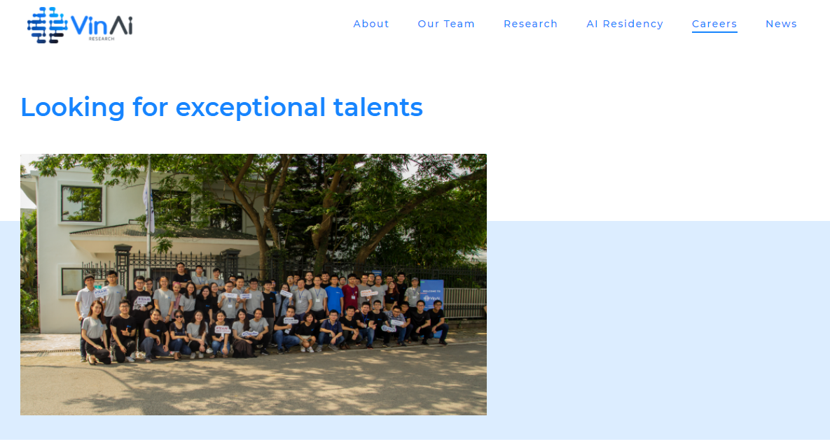
Existing System
VinAI Careers
View job, search job
View information of the company
Jobs are sorted for easy searching

Slide 12
Proposal System
Build a professional recruiting website for the FPT Education system. The proposal is approved by FPT Edu HR Dept and Software Development Dept (App.FEHO)
FPT Education Recruitment System

Slide 13
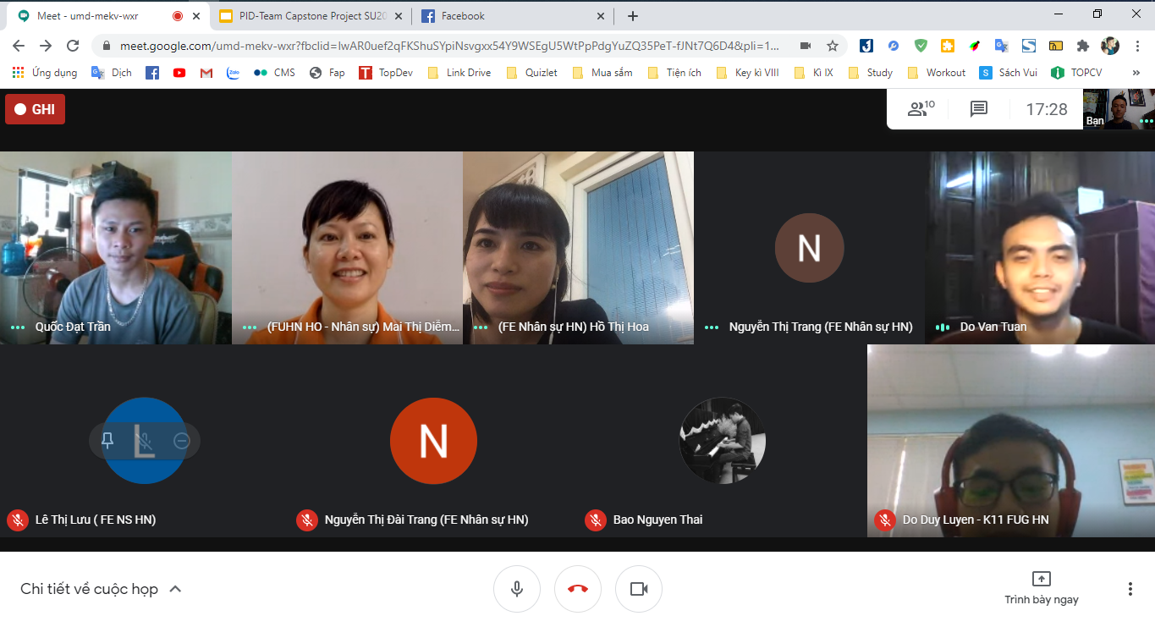
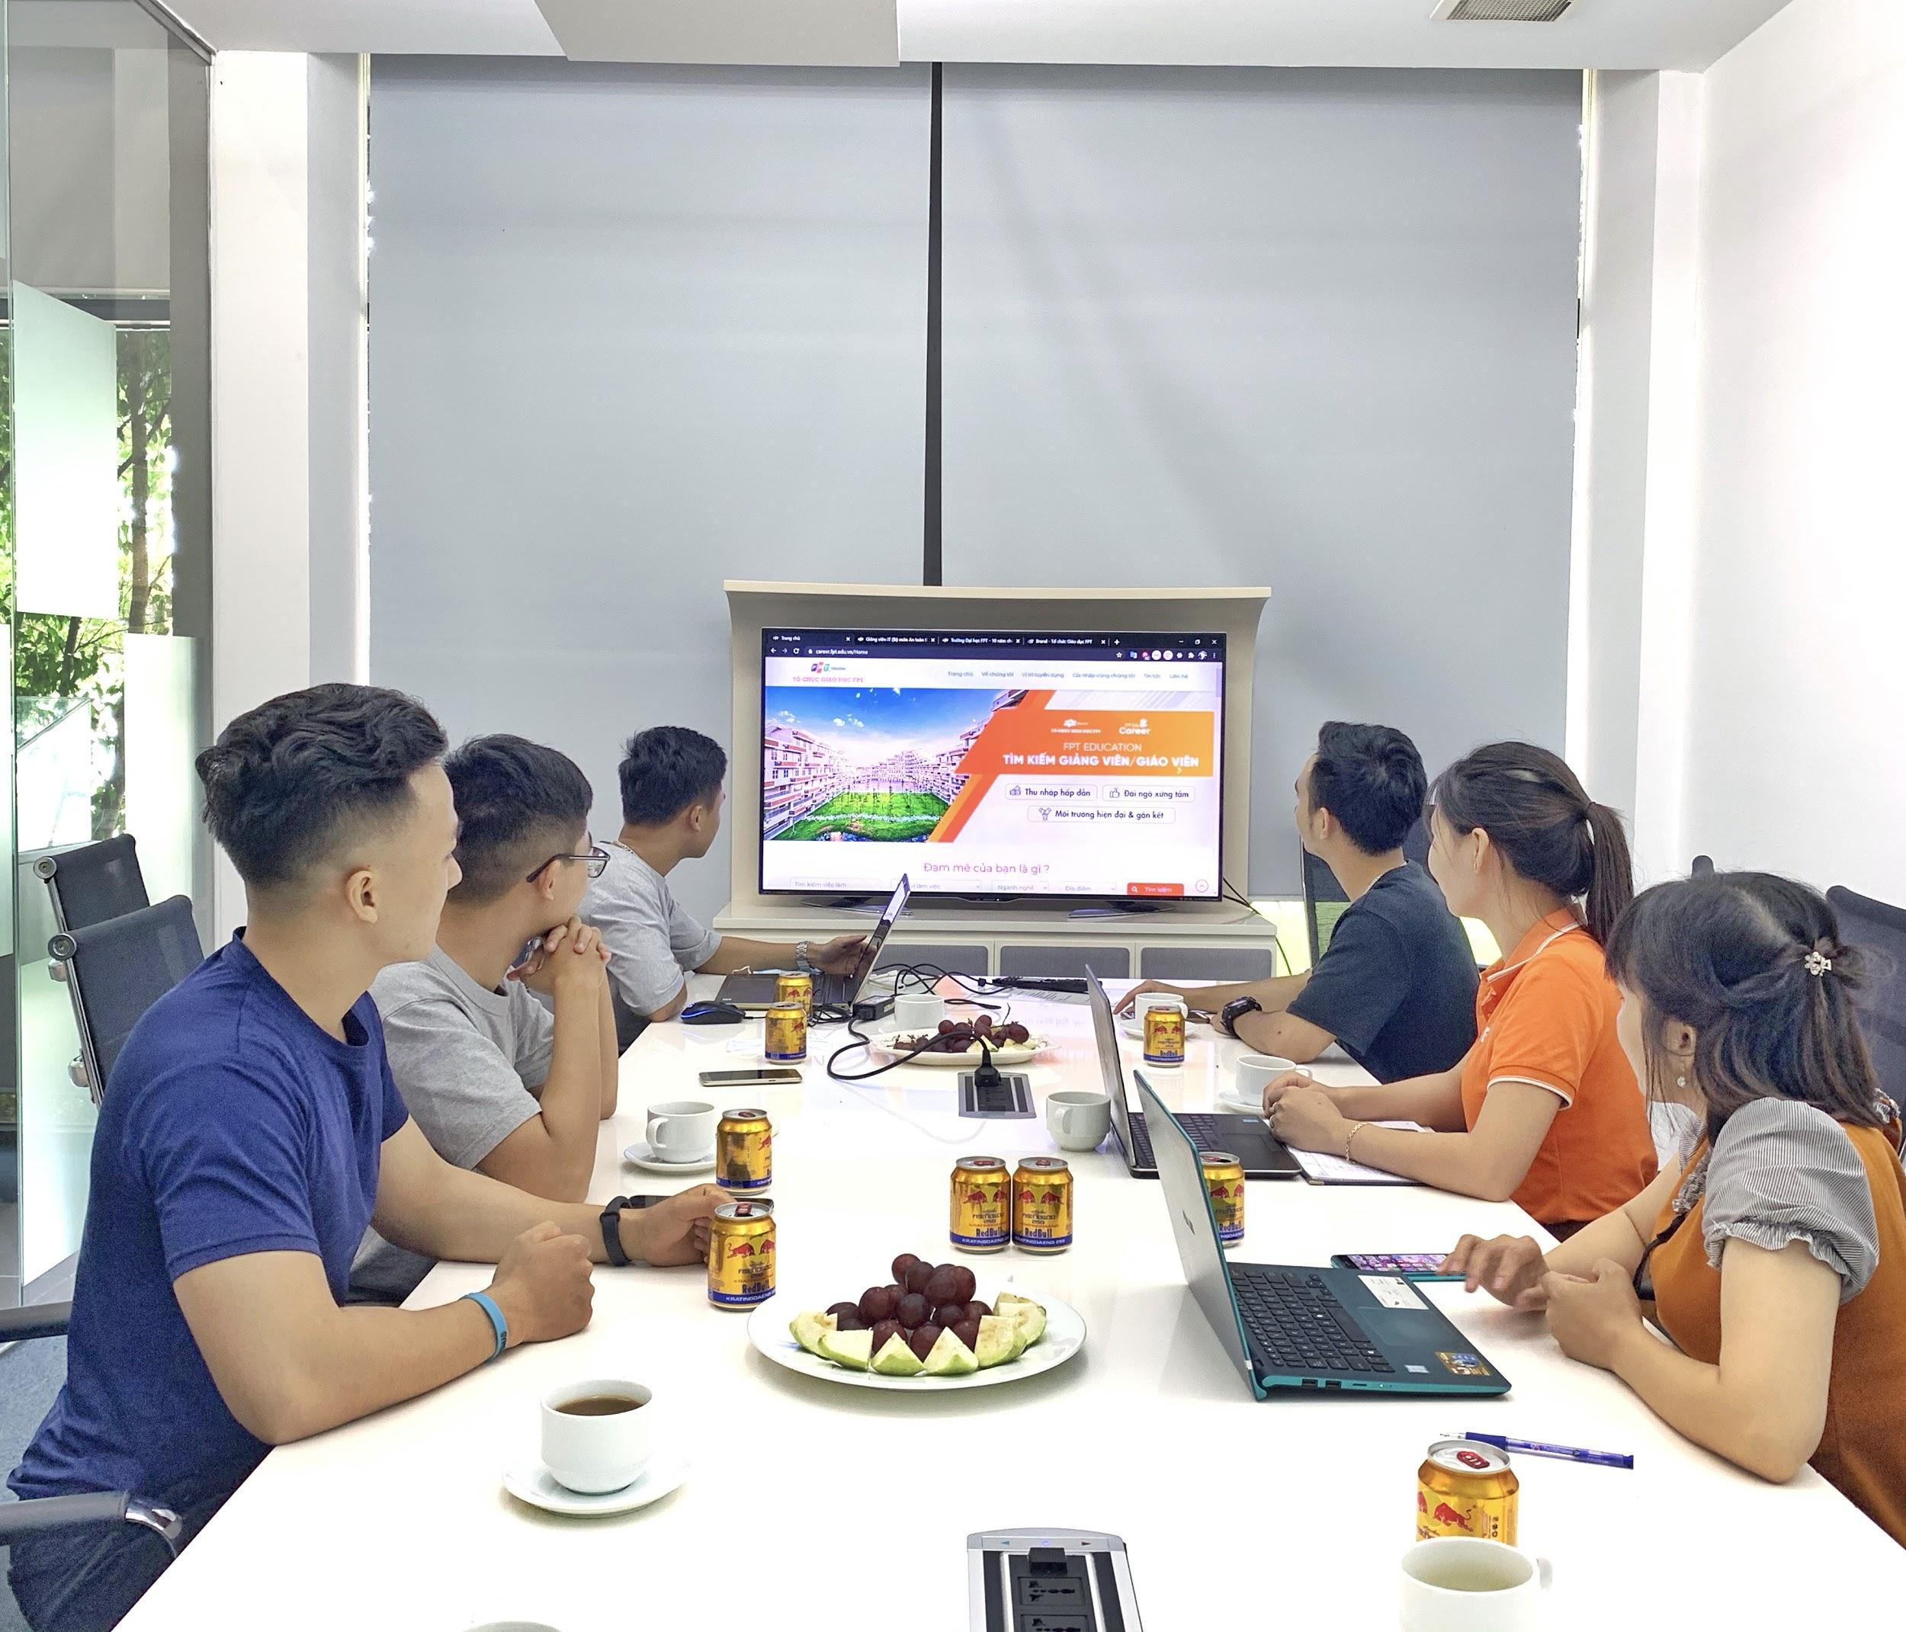
Meetings

Slide 14
3 Type Of Users
Candidate
HR Staff
Super Admin
Users who find a job
Human resources officers
HR Manager

Slide 15
System functions
View all information about FPT Education and new jobs (multiple languages)
Search a job by keywords
Apply for a job:
Has had a CV already → attach CV file (PDF)
Has not had a CV yet → create a simple CV
After successfully uploaded CV → An email will be automatically sent to the candidate
Has not found a suitable job → leave information (register potential candidate)
Do an entry test
Real-time chat with HR Staff
Candidate
HR Staff
Super Admin

Slide 16
System functions
Manage CVs that were uploaded, created or registered by potential candidate. The CV status is in one of the following 5 values: new, seen, pending, rejected, approved.
Choose a quiz to send to candidate
Export list of CVs to excel file
Create jobs and push them to homepage
Candidate
HR Staff
Super Admin

Slide 17
System functions
Super Admin is a person who has the most functionality in the system with manage:
Location
Account
Unit
Career
Config email
Log
Quiz
Question
Question Group.
Candidate
HR Staff
Super Admin

Slide 18
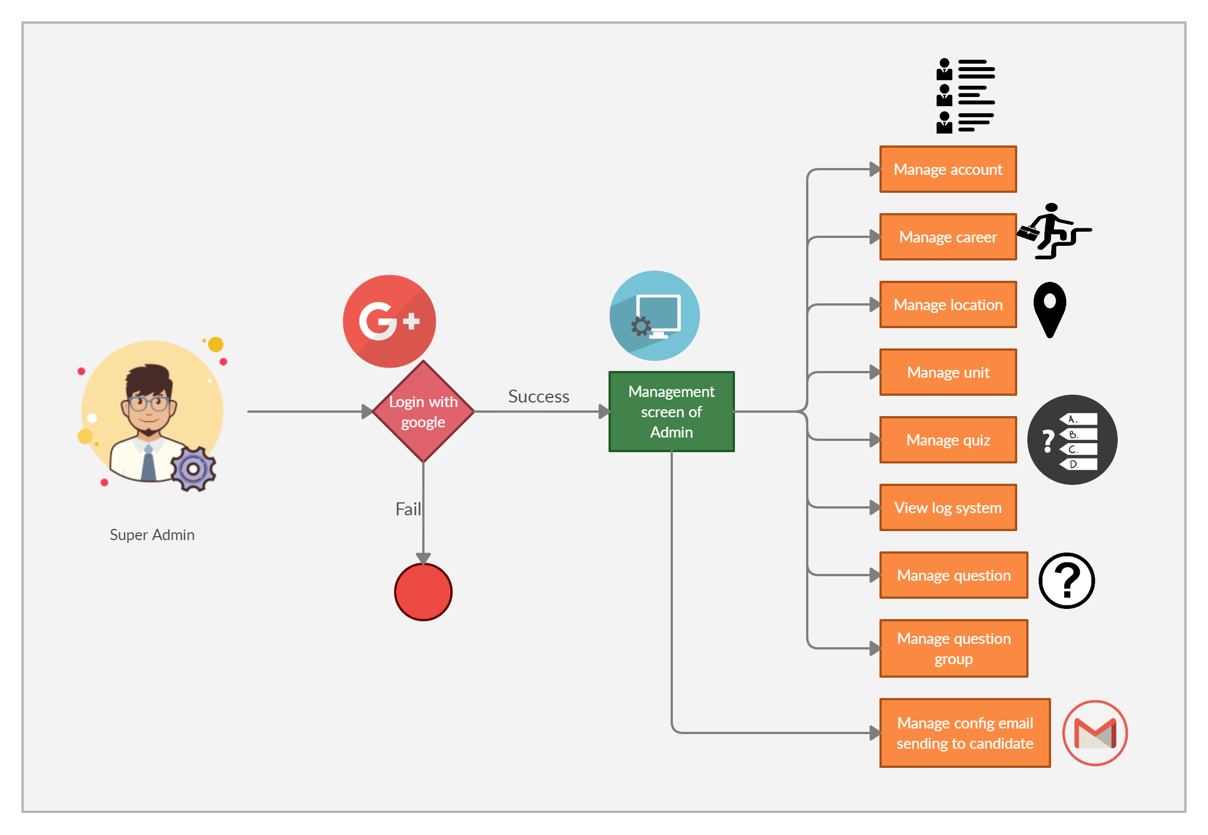
Super Admin

Slide 19
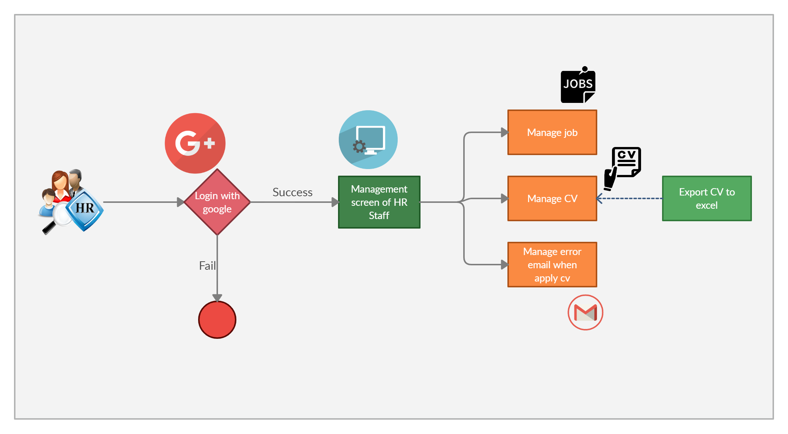
HR Staff

Slide 20
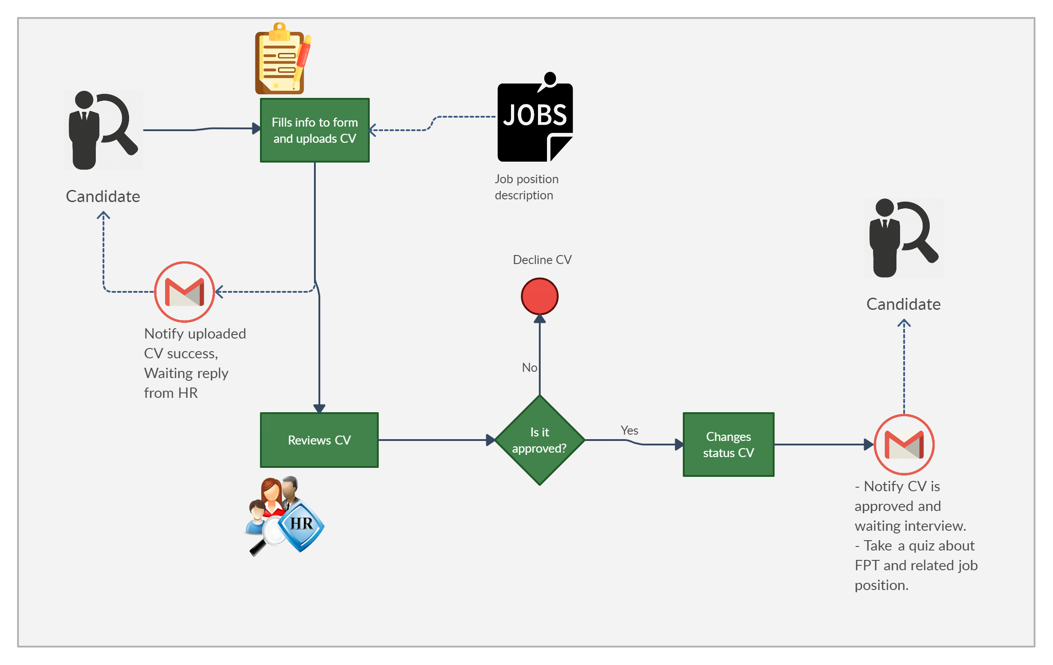
Apply Job Workflows

Slide 21


Out Of Scope Functions
Support multiple languages
Real-time chat between Candidate and HR Staff

Slide 22
Category | Tools and techniques
Programming languages & runtime | C#, Javascript
Frameworks | .Net MVC 4.7
Software architecture | MVC
Operating system | macOS 10.16 Catalina, Windows 10
Version control | GitHub, Git 2.27.0
IDE/Editors | Visual Studio 2017
UML tools | Draw.io, Ashta
DBMS | SQL Server Management System 2012
Project management tools | Microsoft Excel 2016
Process model | Agile Software Process Model
Communication tools | Facebook, Gmail, Slack, Skype
Files management tools | Google Drive
Testing tools | Google Chrome

Slide 23
2.
Project management
plan

Slide 24
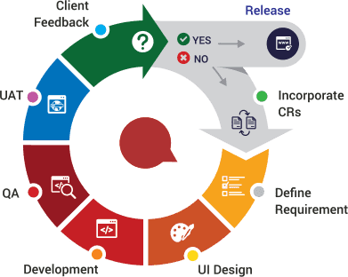
Software Process Model
Agile process model
Notes:
phương thức phát triển phần mềm linh hoạt, được ứng dụng trong quy trình phát triển phần mềm với mục tiêu là đưa sản phẩm đến tay người dùng càng nhanh càng tốt.
Vì
requirement ban đầu chưa được rõ ràng nên đã được thay đổi chỉnh sửa và thêm mới nhiều lần trong quá trình phát triển
thời gian, các chị trong phòng HR muốn xem và test sản phẩm 1 cách nhanh và sớm nhất
=> So Agile model is suite for this system

Slide 25
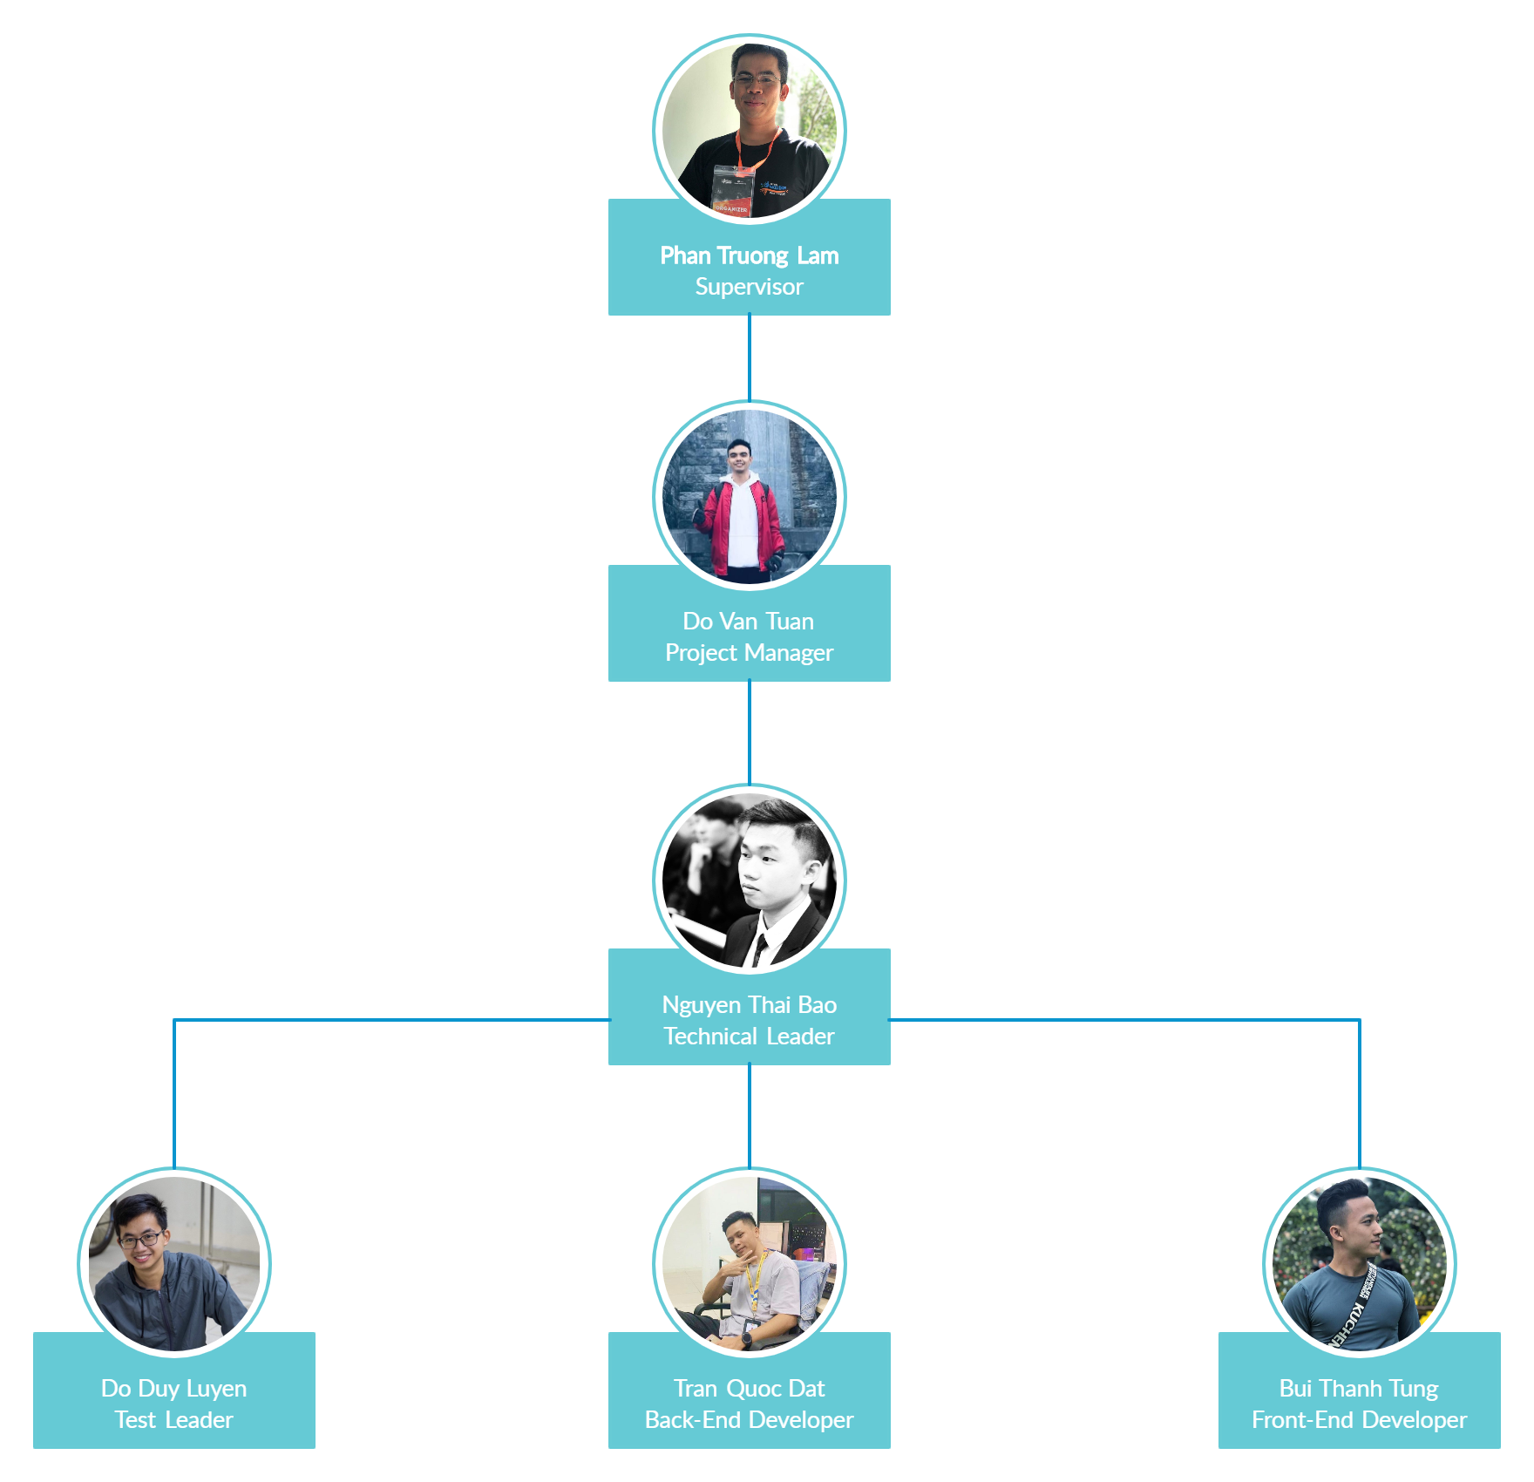
PID Team
Notes:
Với sự dẫn dắt, chỉ đạo sát sao từ thầy hướng dẫn Phan Trường Lâm….

Slide 26
Roles and Responsibilities
Member | Detail Responsibilities
Do Van Tuan | Project Manager, Back-End Developer
Nguyen Thai Bao | Technical Leader, Developer, Quality Assurance Manager
Do Duy Luyen | Front-End Developer, Test Leader, Designer
Tran Quoc Dat | Back-End Developer
Bui Thanh Tung | Front-End Developer, Tester

Slide 27





Teamwork
Meeting supervisor: once a week
Team meeting: once a week
Location: Room R107, Alpha Building, FPT University
Communication:

Slide 28
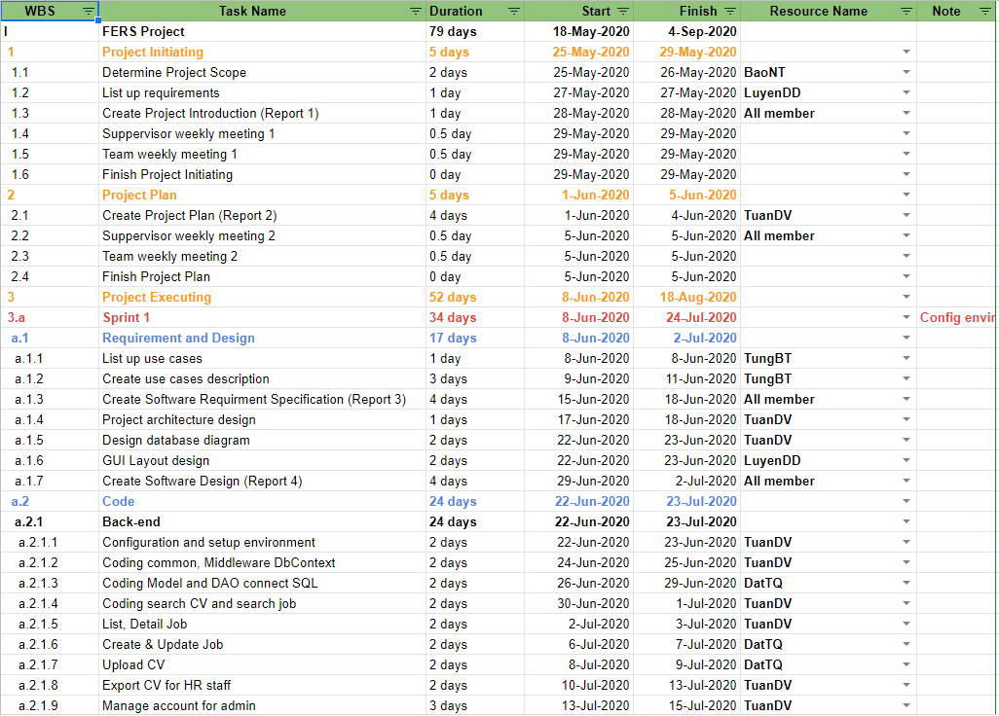
Project Plan

Slide 29
Risk Management Plan
No | Name | Description | Probability | Impact | Prevention | Correction
R1 | Requirement changes | The scope may change; some requirements may be added | High | Medium | All member discuss carefully in the beginning of each iteration to define scope and requirements | Ensure resource allocation is modified correctly to adapt to new requirement
R2 | Illness or absence of team members | The number of members decreases and not enough for work | Medium | Low | Members have to notify the team about the absence period and the plan of how to keep up with the work process. | Ensure that the absence of a member won’t affect others and always have plans to deal with this problem
R3 | Conflict among team members | Team member disagree with others and refuse to work or work below their ability | Medium | High | Define clear tasks and unify the opinion before starting tasks | All members discuss to resolve the conflict. Voting.
... | ... | ... | ... | ... | ... | ...

Slide 30
3.
Software Requirement
Specification

Slide 31
Software Requirement Specification
01
02
03
Entity Relation Diagram
Software requirement specification
Non-functional Requirement

Slide 32
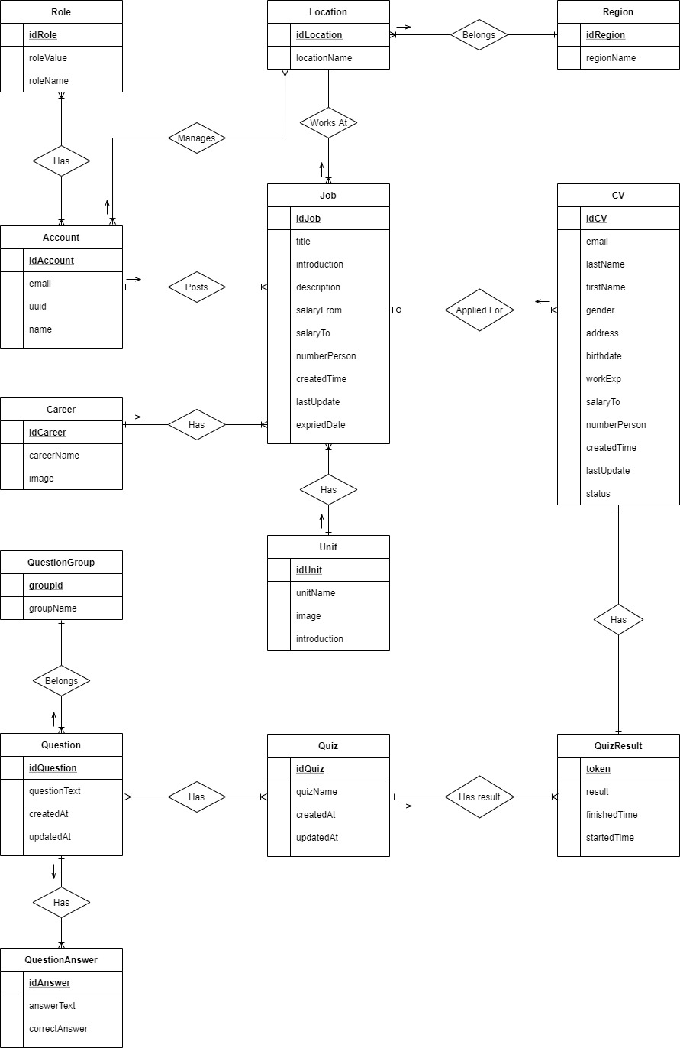
Entity Relation Diagram

Slide 33
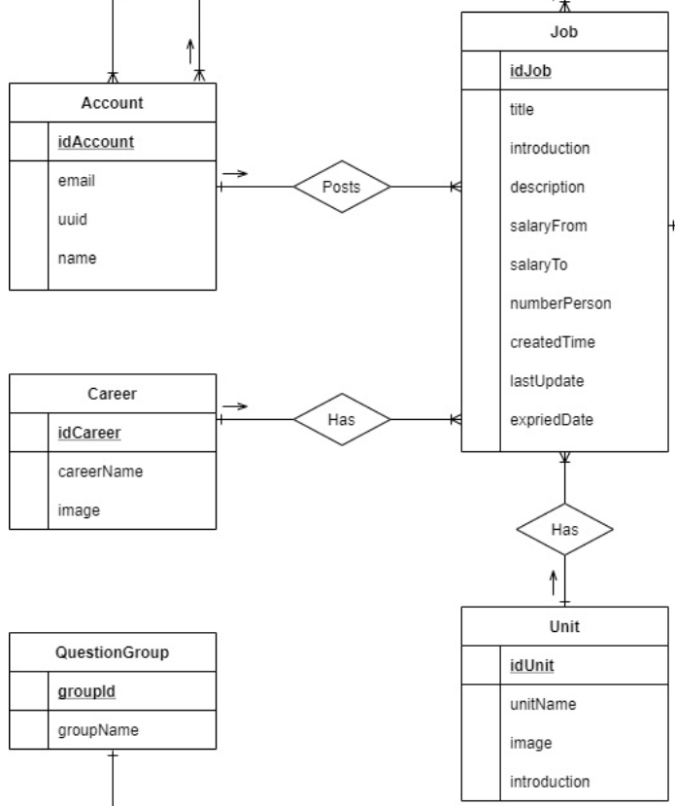
Entity Relation Diagram

Slide 34

Software Requirement Specification
External interface requirements
User interfaces
Standard user interface:
Font-family: Montserrat
Font-size: 16px
Icon: Font Awesome 5
Colors: The main is #F36523
Screen resolution:
Supports responsiveness for screens: mobile, desktop, tablet, laptop.

Slide 35

Software Requirement Specification
External interface requirements
Software interfaces
Connecting to database: Microsoft SQL Server
Transfer protocol: HTTPS, TCP/IP
Uses Simple Mail Transfer Protocol (SMTP) to automatically send email.

Slide 36
Software Requirement Specification
System features
12
Candidate
64
34
Super Admin
16
HR Staff
2
Supper Admin & HR Staff
Use cases

Slide 37
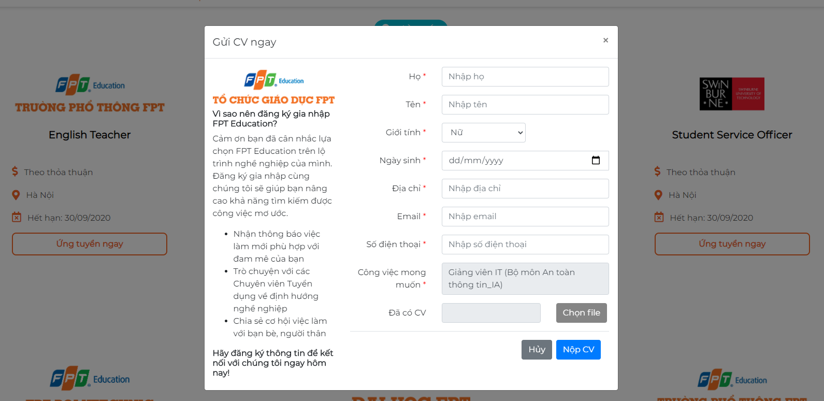
Software Requirement Specification
Candidate
• Upload CV
• Search job

Slide 38
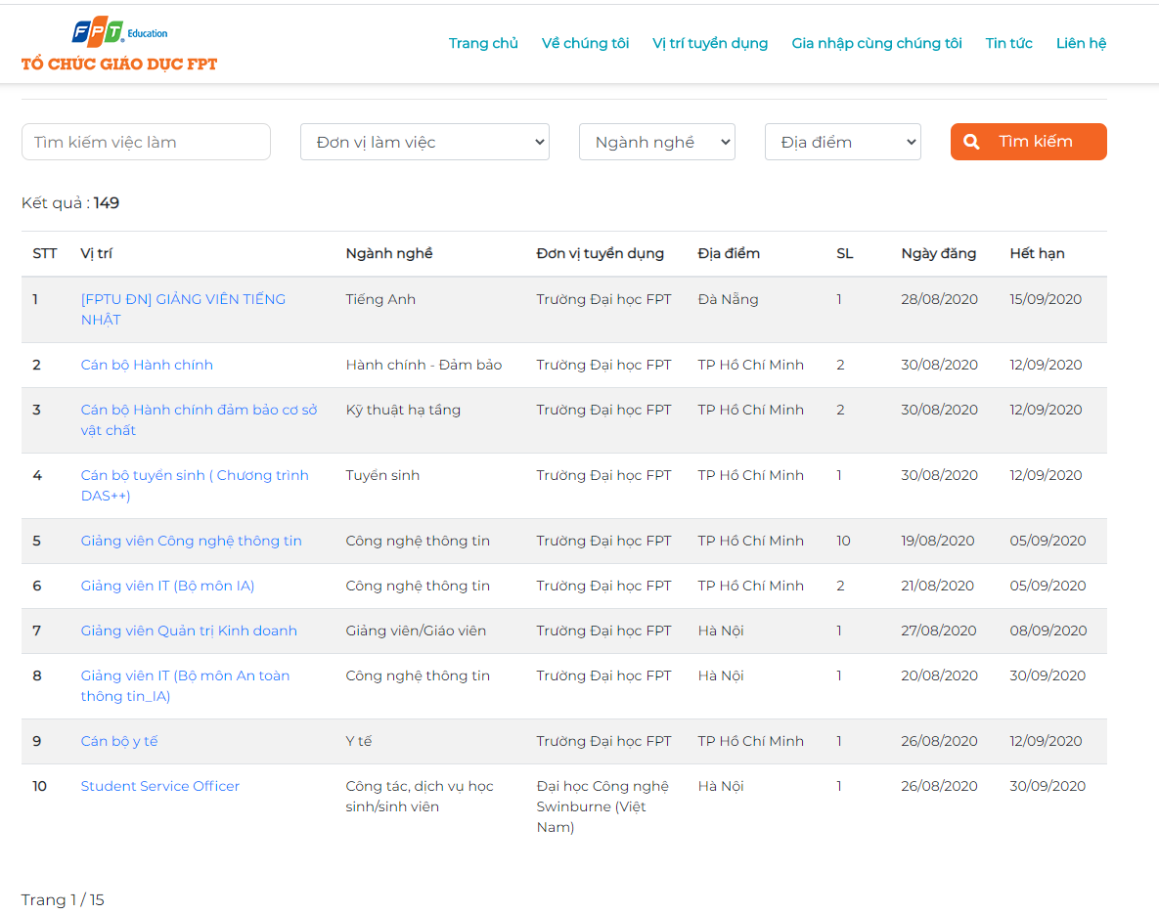
Software Requirement Specification
Candidate
• Upload CV
• Search job

Slide 39
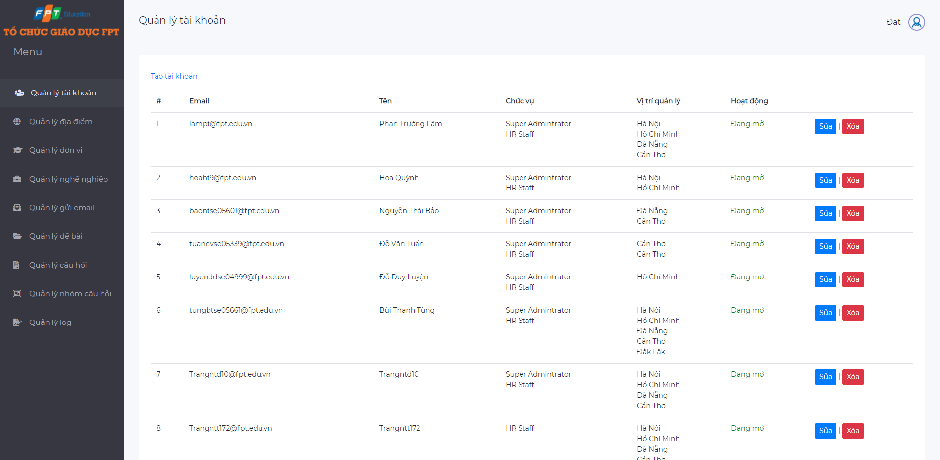
Software Requirement Specification
Admin
• Manage accounts
• Manage units

Slide 40
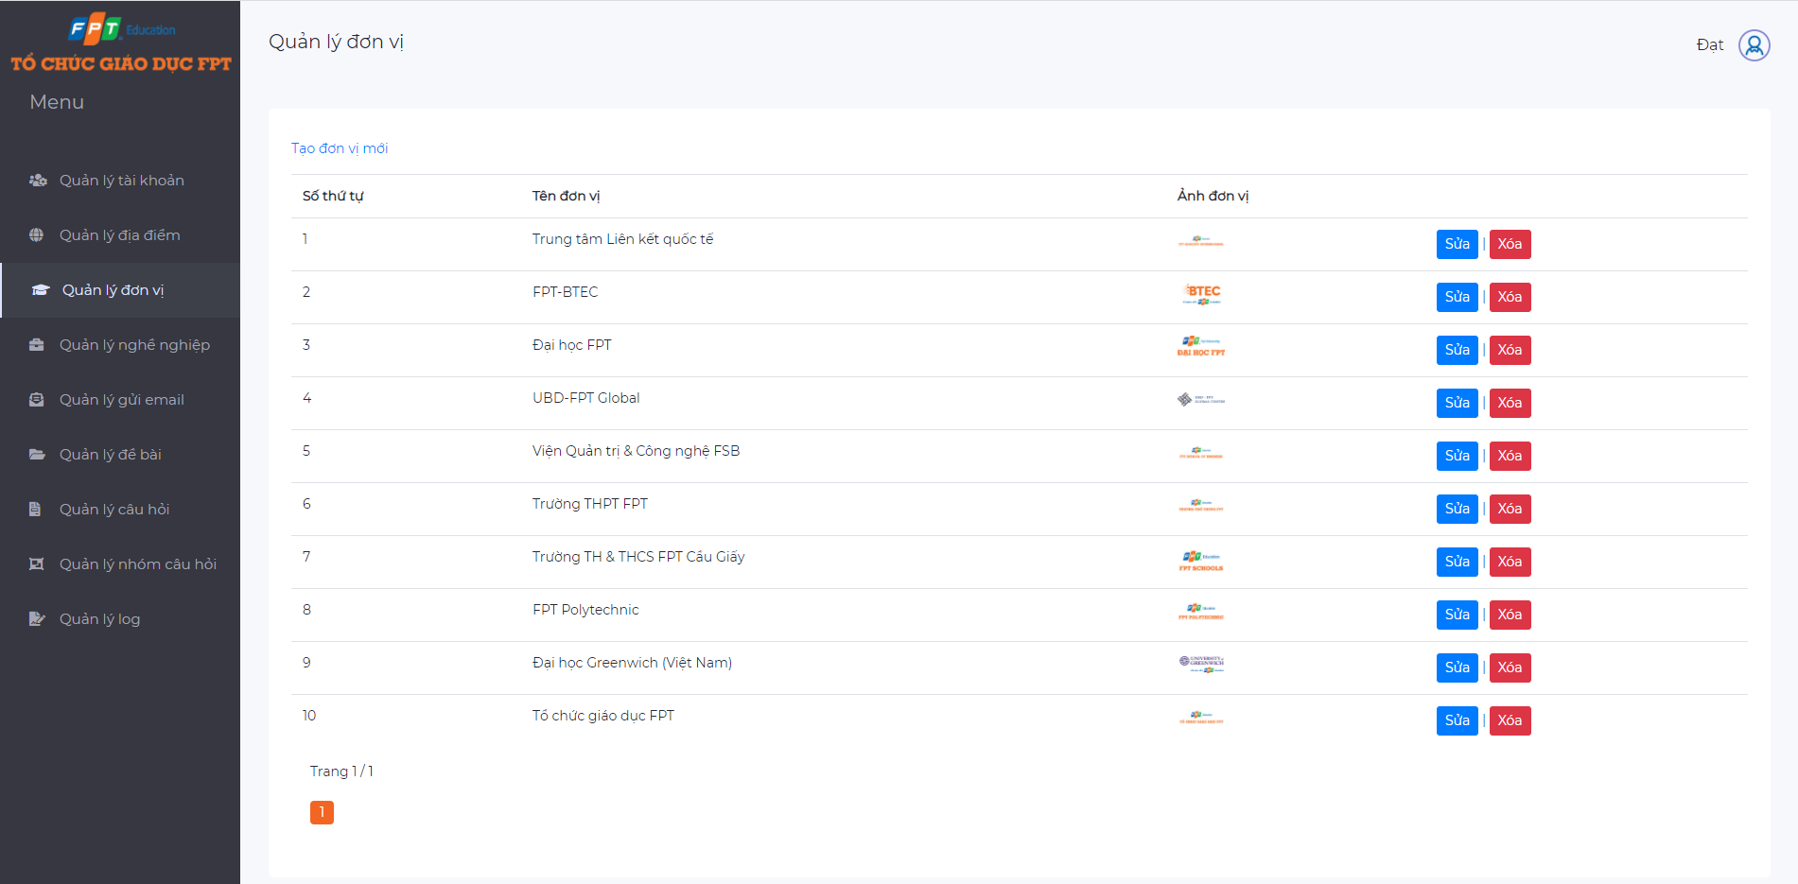
Software Requirement Specification
Admin
• Manage accounts
• Manage units

Slide 41
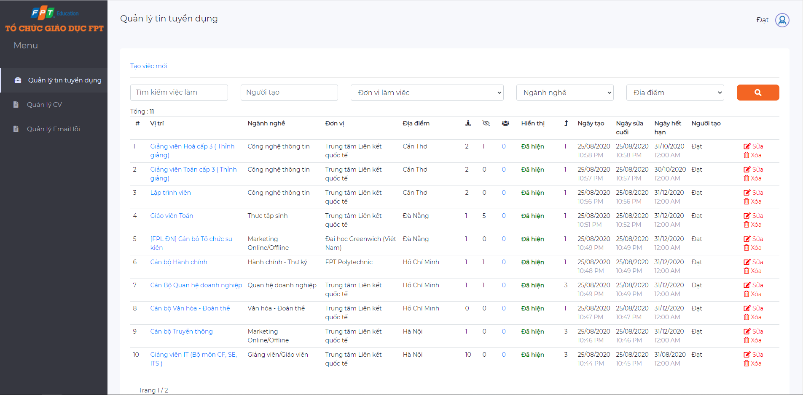
Software Requirement Specification
HR Staff
• Manage jobs
• Manage CVs

Slide 42
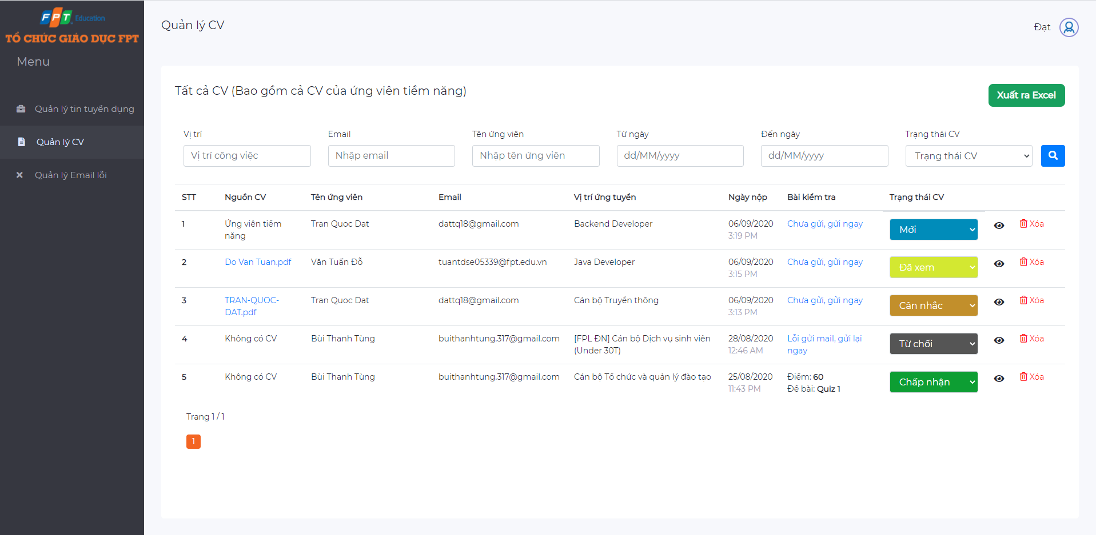
Software Requirement Specification
HR Staff
• Manage jobs
• Manage CVs

Slide 43
Non-functional Requirement
Security
Use Google accounts belonging to FPT organization and registered in the system to sign in.
Use HTTPS to encrypt the information transferred between clients and servers.
Sends a quiz link via the candidate's email address and secured, authorized by a token generated by the system.
Reliability
Maintainability
Portability

Slide 44
Non-functional Requirement
Security
All data entered by the user is validated before sending it to the server
The system complies with business rules
Reliability
Extensibility
Maintainability
Portability

Slide 45
Non-functional Requirement
Security
Using .NET MVC 4.7:
Divide the application Model, Controller and View.
We can easily maintain.
Many developers can work at a time. It will not affect to another developer.
It supports TDD (test-driven development).
Reliability
Maintainability
Portability

Slide 46
Non-functional Requirement
Security
Supports responsiveness for devices: mobile, desktop, tablet, laptop (For candidate view).
Reliability
Maintainability
Portability

Slide 47
4.
Software
Design

Slide 48
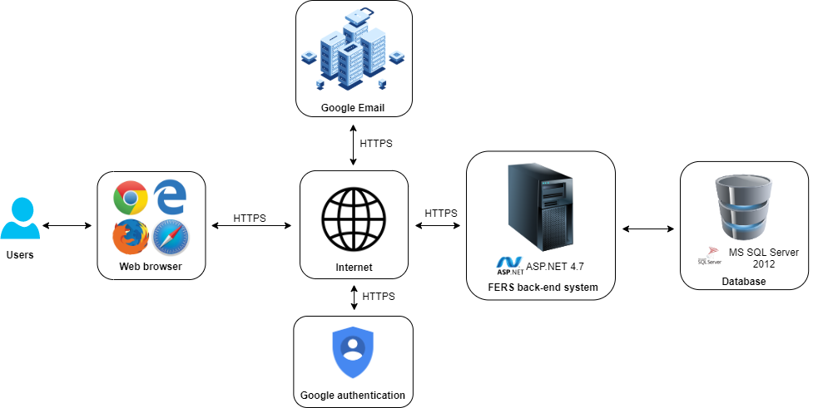
System Overview

Slide 49
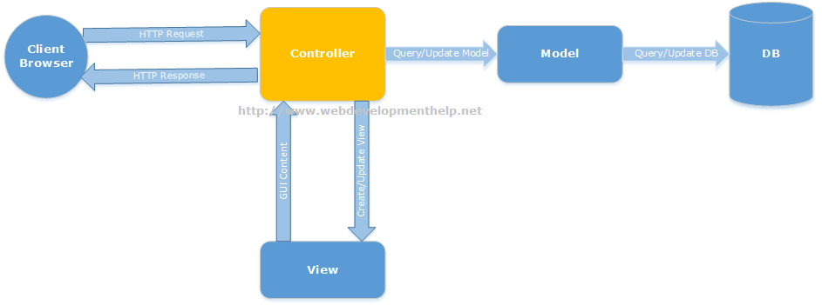
Architecture Design
Notes:
MVC là mô hình tiêu chuẩn , được hỗ trợ bởi những web frameworks phổ biến

Slide 50
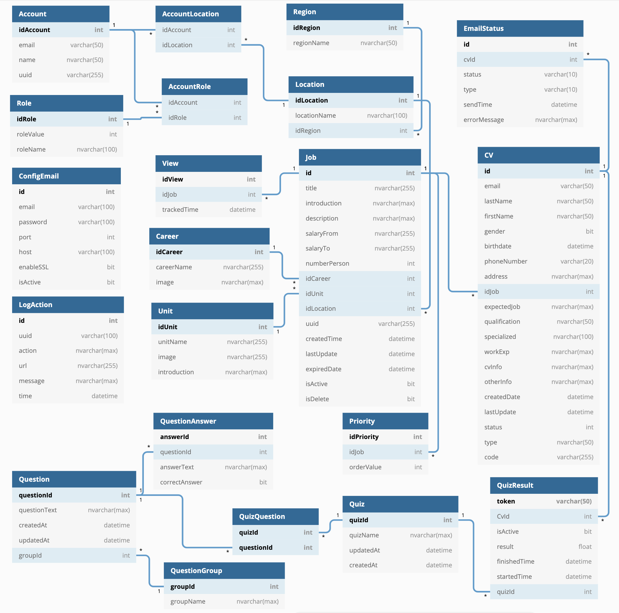
Database
Design

Slide 51
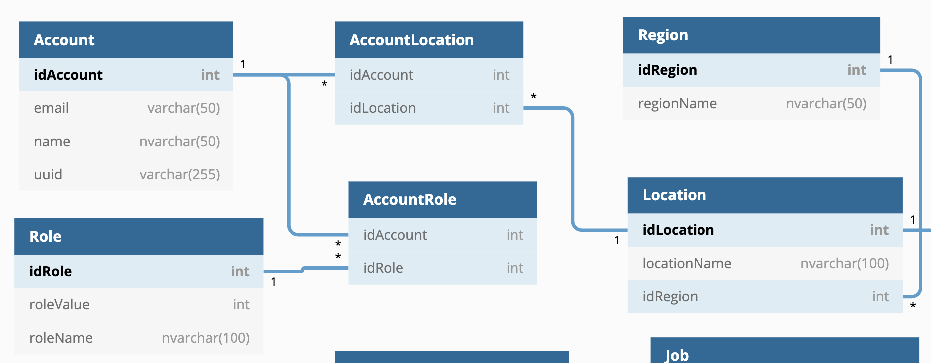
Database
Design

Slide 52
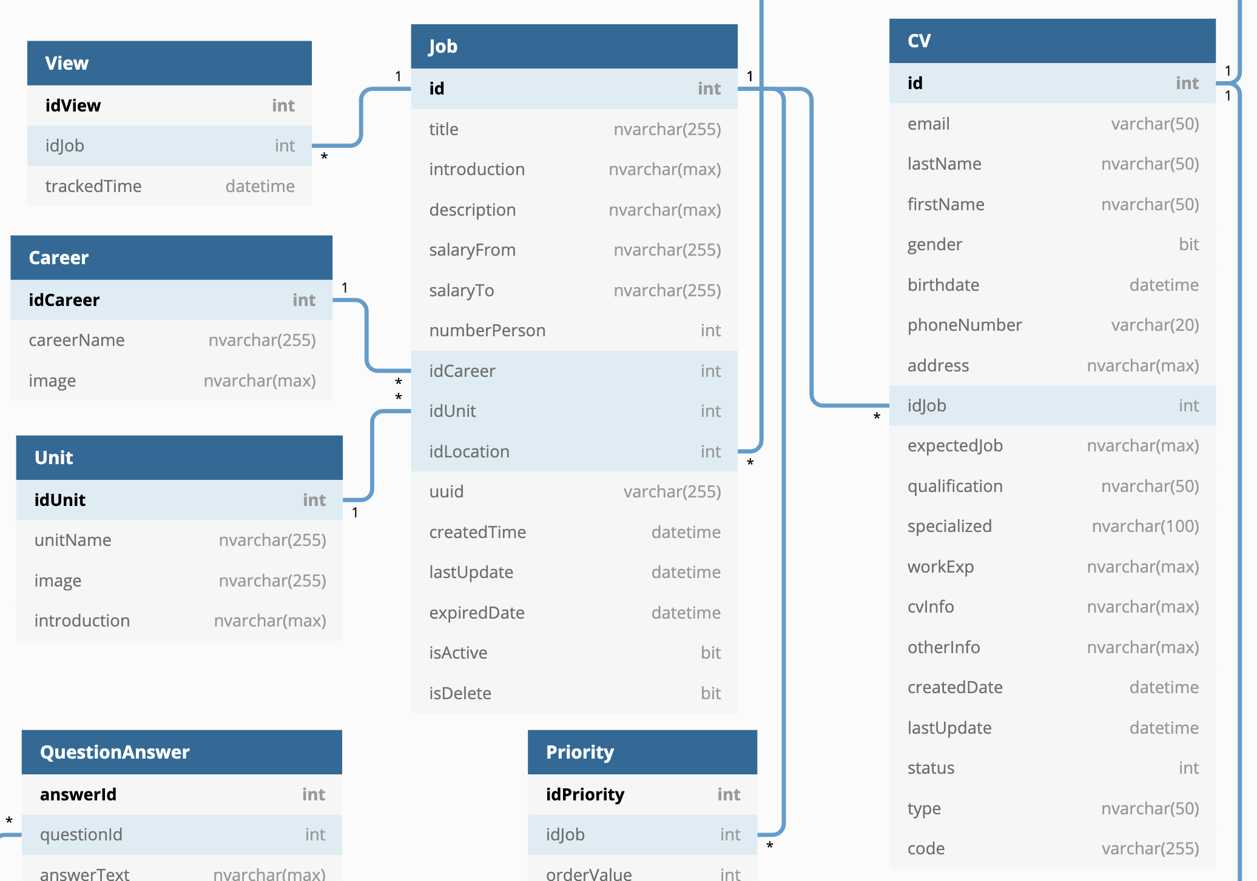
Database
Design

Slide 53
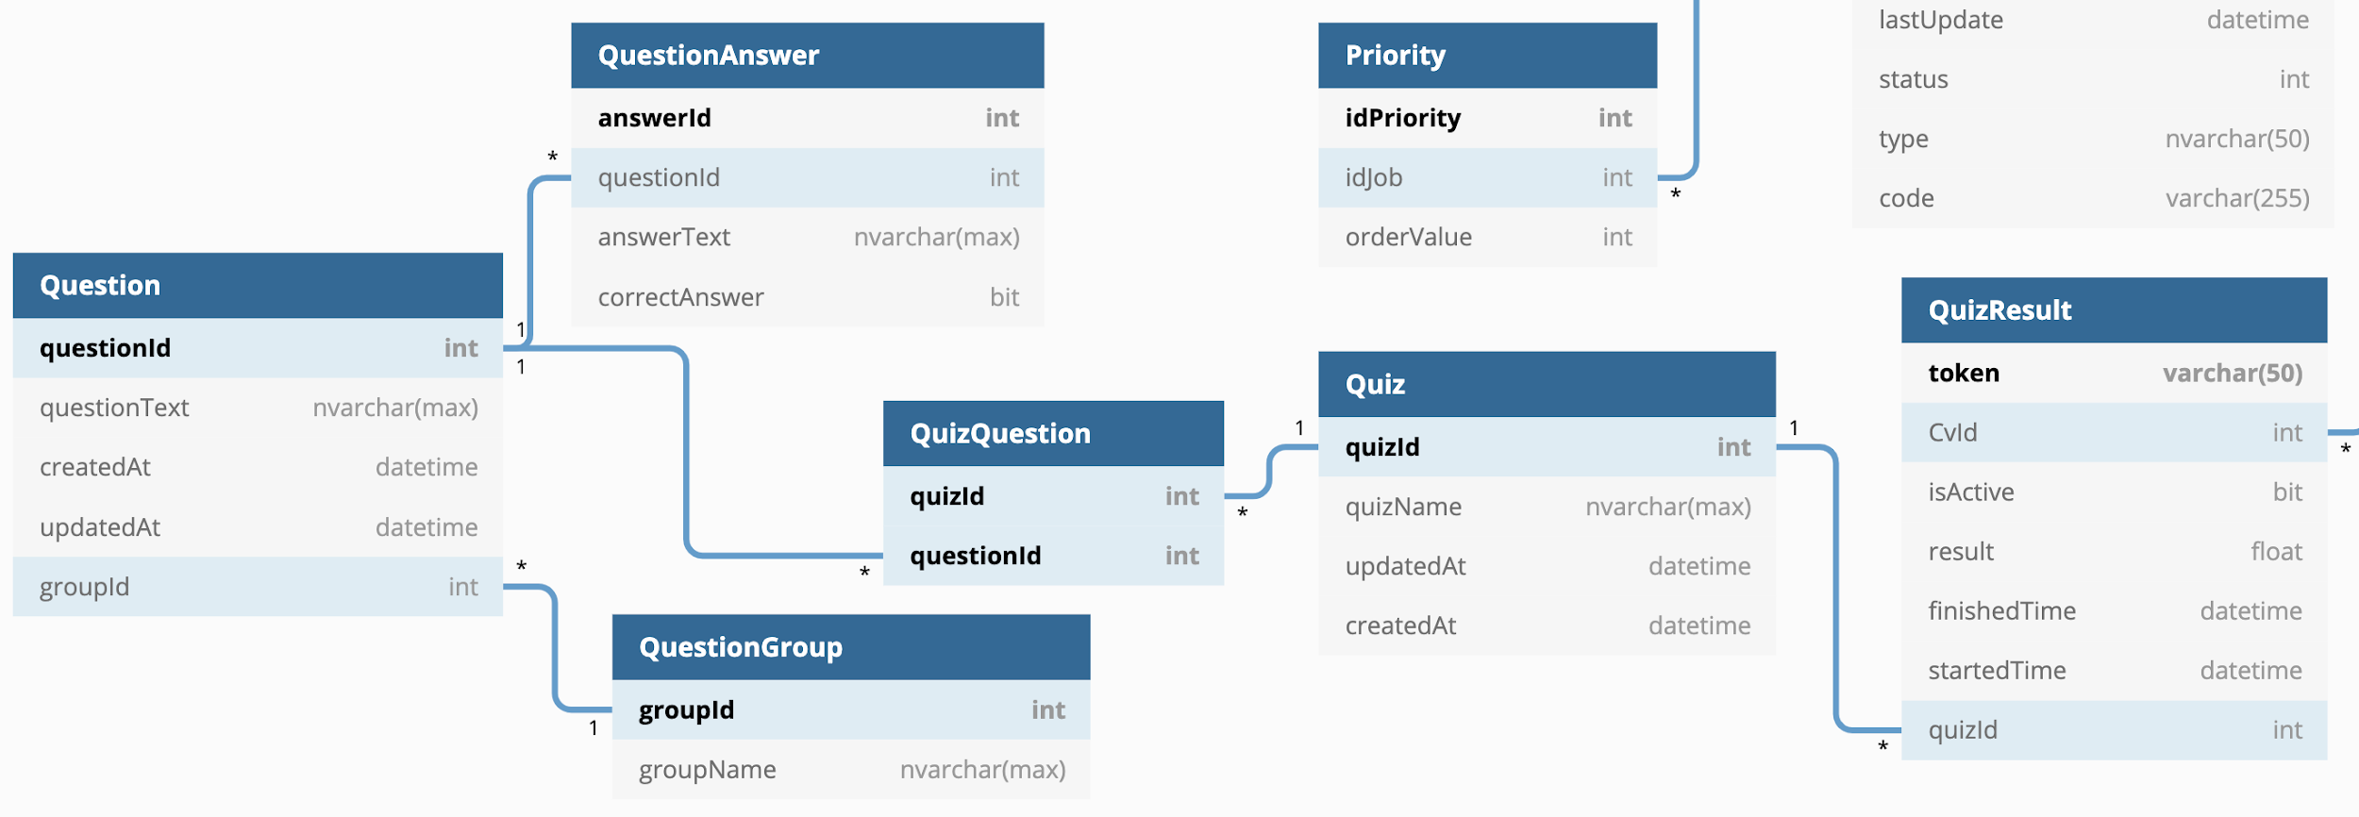
Database
Design

Slide 54
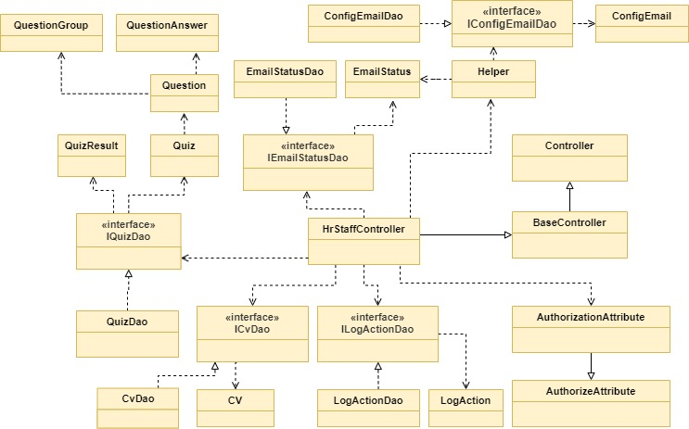
Class Diagram
Manage CV Class Diagram
Notes:
Class diagram mô tả kiểu của các đối tượng trong hệ thống và các loại quan hệ khác nhau tồn tại giữa chúng.
Là một kỹ thuật mô hình hóa tồn tại ở tất cả các phương pháp phát triển hướng đối tượng.

Slide 55
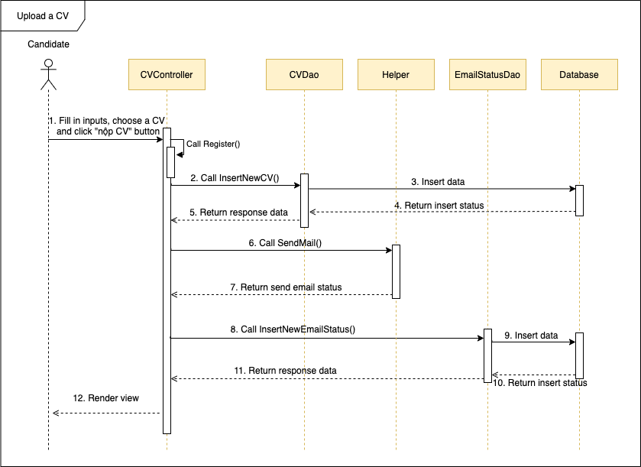
Sequence Diagram
Upload a CV sequence diagram
Notes:
Sequence Diagarm là bản vẽ mô tả sự tương tác của các đối tượng để tạo nên các chức năng của hệ thống.
Bản vẽ này mô tả sự tương tác theo thời gian nên rất phù hợp với việc sử dụng để thiết kế và cài đặt chức năng cho hệ thống phần mềm.

Slide 56
5.
Testing

Slide 57
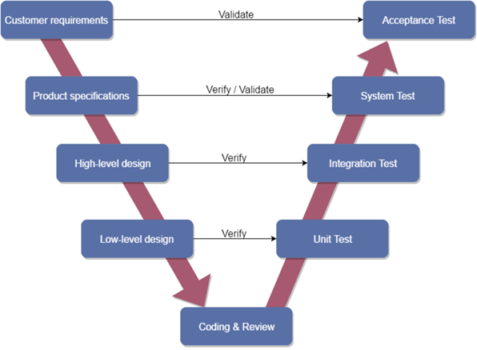
Testing Model
V-Model
Notes:
https://viblo.asia/p/mo-hinh-phat-trien-phan-mem-v-la-gi-07LKXwAr5V4
LLD: Trong giai đoạn này mỗi thành phần phần mềm đều được thiết kế riêng. Các, mối quan hệ và sự phụ thuộc của họ, sơ đồ kiến trúc, bảng cơ sở dữ liệu; Các method, class, giao diện, các kiểu dữ liệu vv đều được hoàn tất trong giai đoạn này -> Unit test: kiểm tra xem đoạn code có cho kết quả mong muốn hay không. Thử nghiệm này về cơ bản được thực hiện bởi Dev.
HLD: Nhóm sẽ nghiên cứu và điều tra về các yêu cầu có thể được thực hiện như thế nào .Nhóm sẽ nghiên cứu và điều tra về các yêu cầu có thể được thực hiện như thế nào. Tính khả thi về mặt kỹ thuật của yêu cầu cũng được tìm hiểu-> Integration test: test tích hợp được thực hiện đã được tạo ra trong giai đoạn HLD, xác nhận xem các thành phần của ứng dụng có hoạt động với nhau như mong đợi hay không.
PS -> system test: kiểm tra thực tế hoạt động của ứng dụng diễn ra
AT: xác nhận rằng các yêu cầu kinh doanh được đáp ứng trong môi trường người dùng

Slide 58
Testing Stages
Unit Testing
Integration Testing
System Testing
Acceptance Testing
Notes:
https://viblo.asia/p/system-testing-kiem-thu-he-thong-aWj53pOPK6m

Slide 59
Testing Type
Type of test | Stage of test
 | Unit testing | Integration testing | System testing | Acceptance testing
Unit test | ✔ | ✔ | ✔
GUI test |  |  | ✔ | ✔
Function test | ✔ | ✔ | ✔ | ✔
Acceptance test |  |  |  | ✔

Slide 60
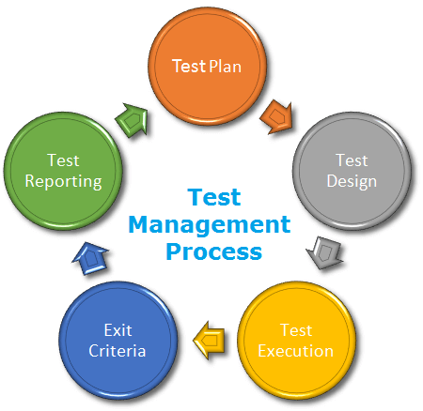
Testing Process
Notes:
● Test Planning use requirement specification test plans will make more detailed decisions
about the overall approach of testing.
● Test Design design and create test cases.
● Test Execution execute test procedures using test execution tools, check actual results with
expected results.
● Exit criteria defines when to stop testing based on time.
● Test reporting activities update Test Report and if there is an error then report error to
developer.

Slide 61
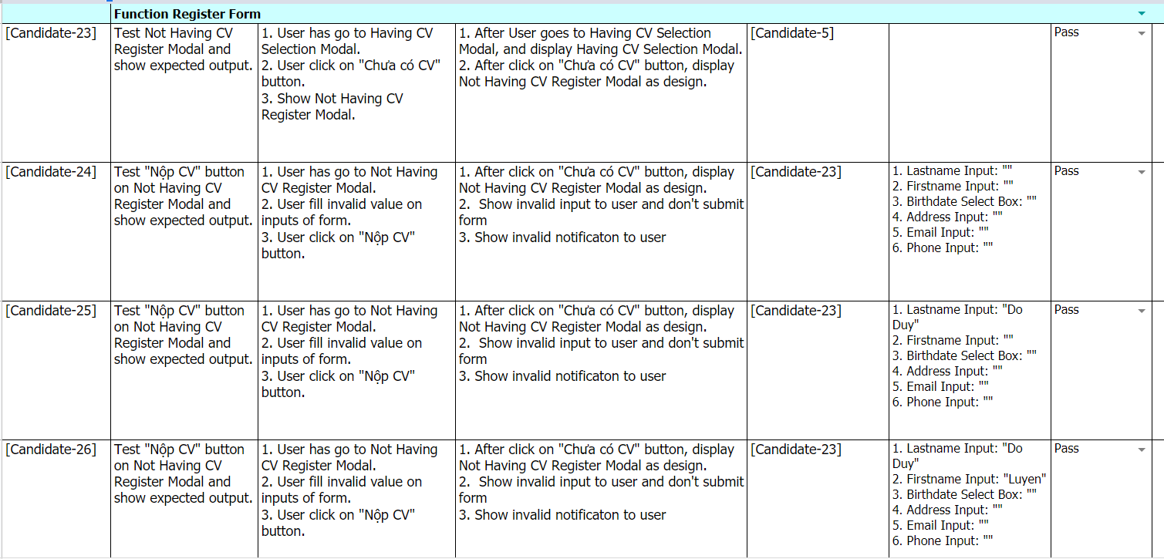
Test Cases
Test case register form

Slide 62
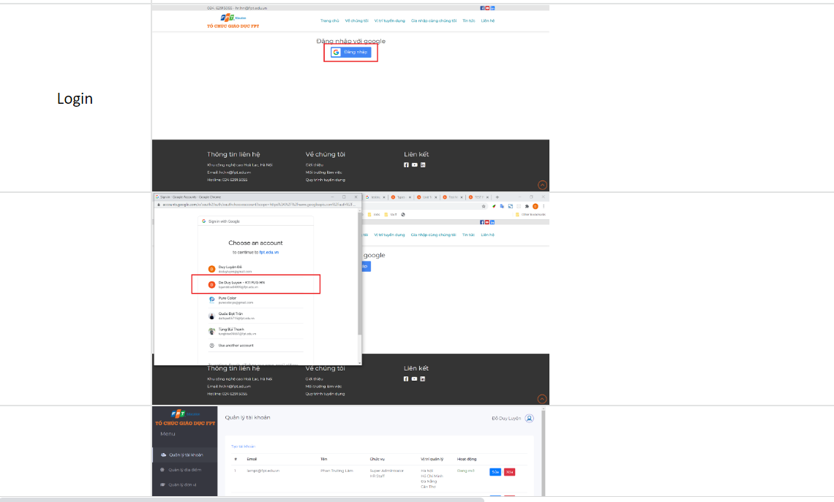
Integration Test Evidence

Slide 63
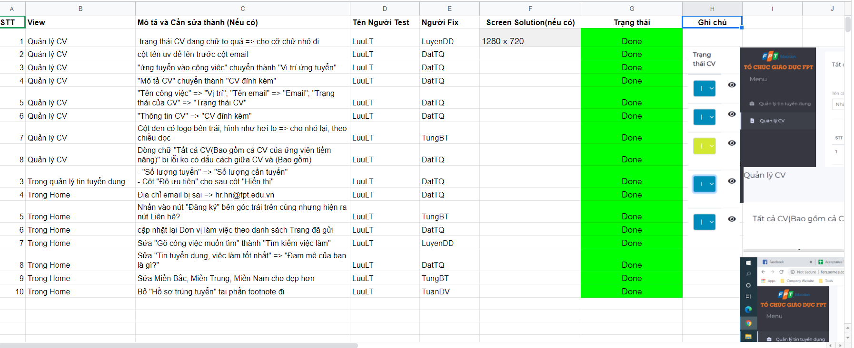
Acceptance Test
Acceptance Test

Slide 64
Checklist
Checklist | Yes | No
Candidate’s screens have responsive for mobile, laptop, desktop devices | ✔
All error messages are displayed using red color. | ✔
Unavailable pages are redirected to the error page. | ✔
Input date of birth must be greater than 18. | ✔
... | ... | ...

Slide 65
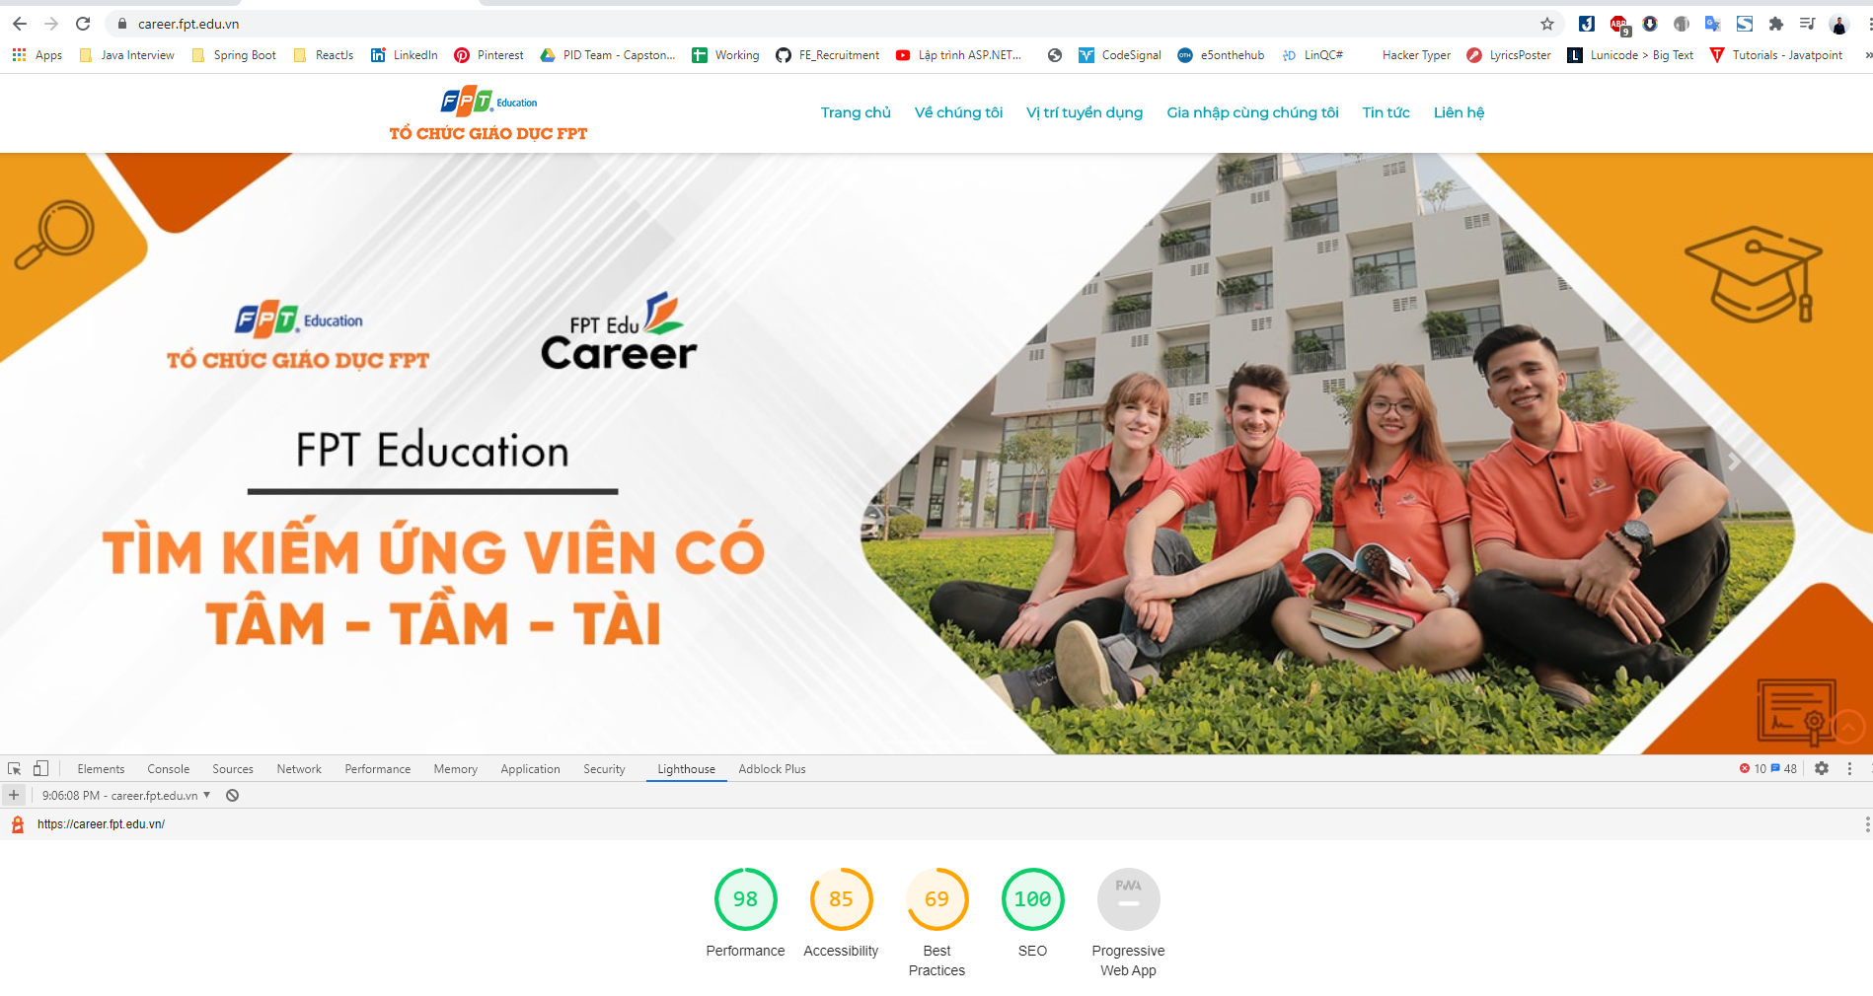
Performance Test
Performance Test

Slide 66
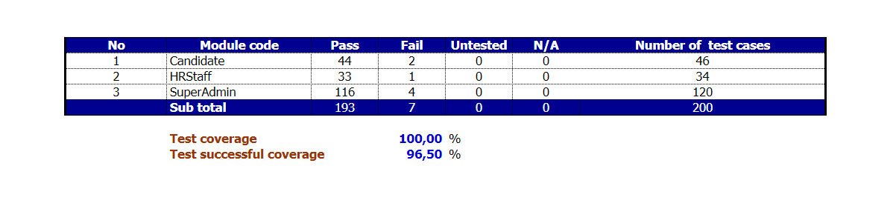
Test Report
Test Report

Slide 67

Deployment
Notes:
IIS là một phần mềm máy chủ web có thể mở rộng được tạo bởi Microsoft để deploy hệ thống

Slide 68
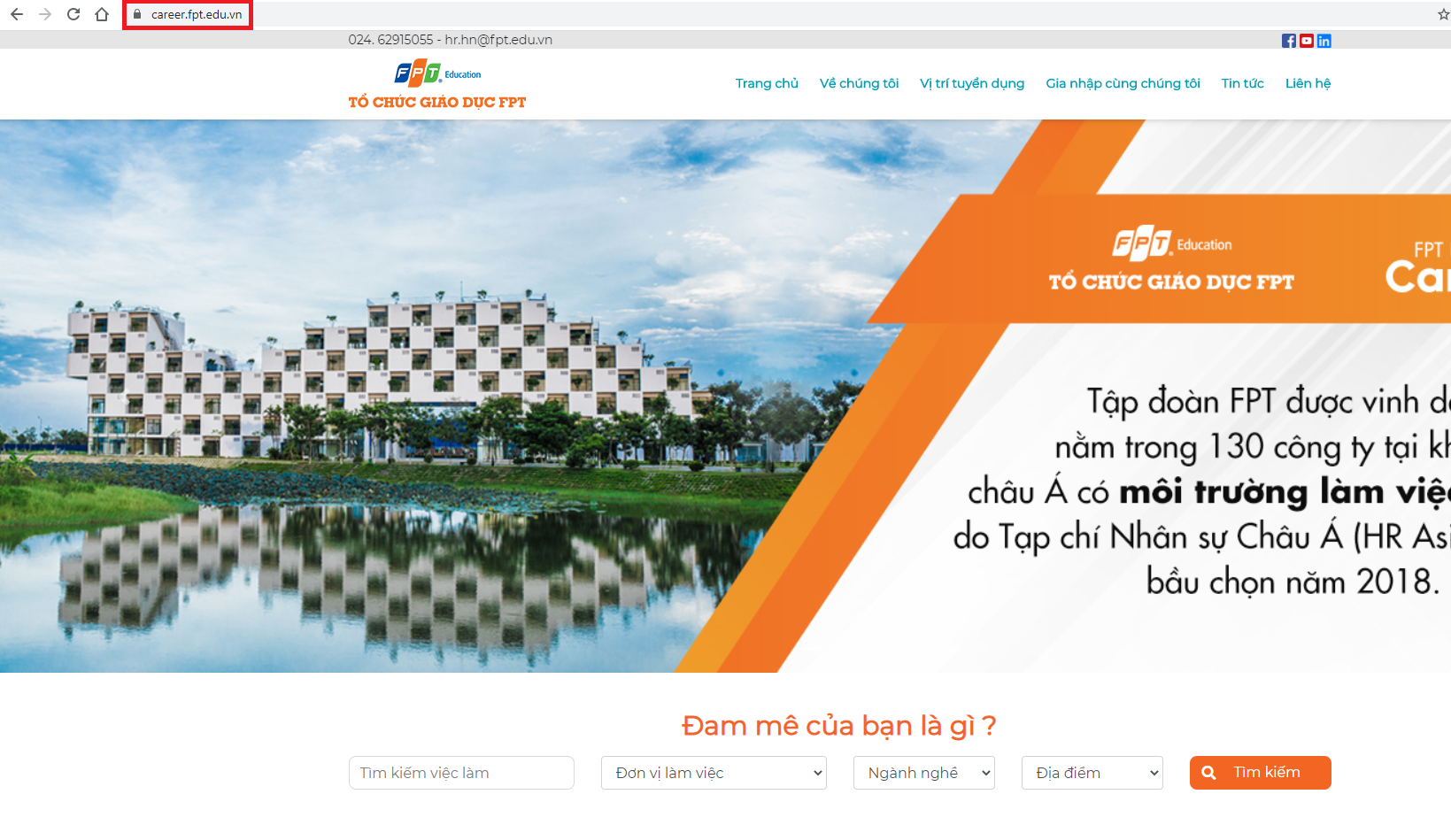
Go live

Slide 69
6.
Demo & QA

Slide 70
THANK YOU
FOR LISTENING

